Slide 1
DuraMax
High-performance motors
Presenter’s name
June 22, 2021

Slide 2
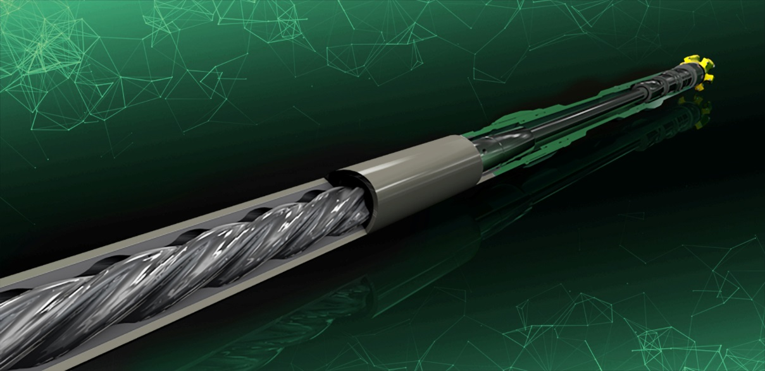


Modern motor solution
Highly engineered and fully modeled motor offering
Increased operational envelope
Robust and durable
Multi-run capable tools
Copyright 2020 Baker Hughes Company. All rights reserved. 81664
Notes:
Going forward we want to flip this around and
Standardize to a high load capable design that can be re-run multiple times with minimal effort
As well as be quickly configured into any service level
Higher CE, reduced inventory, reduced GBV, reduced R&M cost, higher FM and returns
1-2-1 Vision
Automation, automation, automation
Automatic programming, BHA build
Automatic deck testing, tool programming, tool verification
Automatic configuration of telemetry, automatic telemetry synchronization
Automatic reporting and update of performance recording data bases
Auto Self-Diagnostics of 121 Platform components support re-run decisions
One button log generation
Reduces training needs for FSEs, reduced number of FSEs

Slide 3
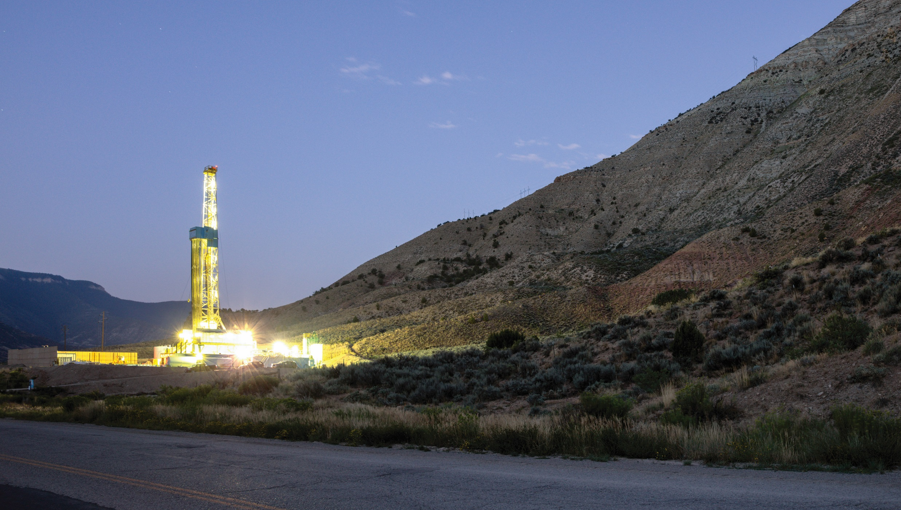
DuraMax motor increased
operational envelope
Higher durability and robustness
Ground up re-design
Modern engineering
Optimized
power sections
New contours
Improved efficiency
Robust elastomer offerings for all mud types
High build rate capability and rotating limits
High strength components
High strength AKO
High WOB capability
High load and long
life bearings
Copyright 2020 Baker Hughes Company. All rights reserved. 81664

Slide 4

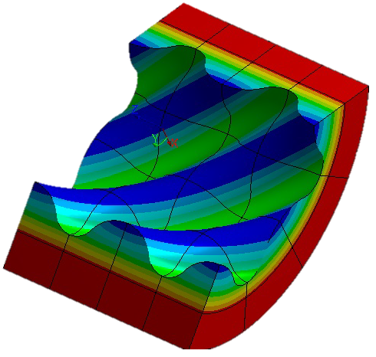
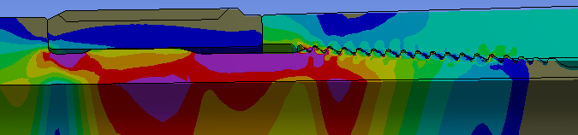
Design overview: Optimized power sections
New stator tube design:
Stronger Baker Hughes proprietary connections
Larger tube ID supporting highest
performance power sections
New contour layout:
Optimized for DOWNHOLE performance
Novel R/S-Fit concept
High flow capable (360gpm)
15% more torque
40% more power output
Wear protection
at conections
New Rotor catcher
Field proven elastomer options
Copyright 2020 Baker Hughes Company. All rights reserved. 81664

Slide 5
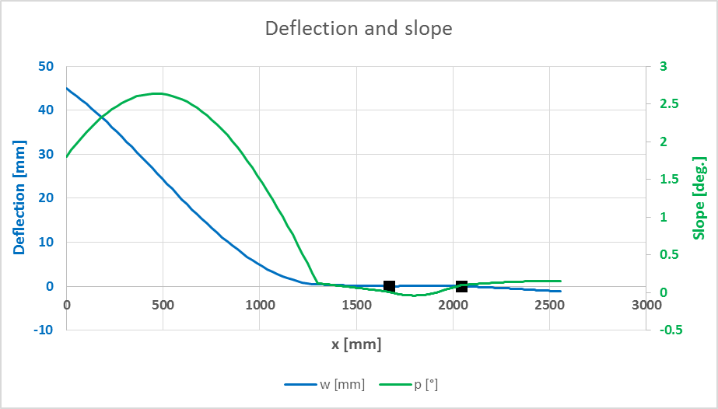
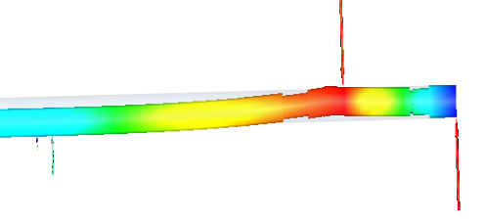

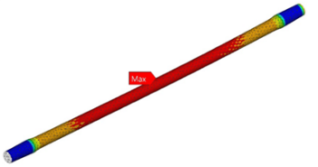
Design overview: Lower end
High load capable bearing assembly:
High WOB up to 180kN / 40 klbs
Short BTB
Withstands highest bit side loads
Improved ako design:
Baker Hughes proprietary thread design
Withstands highest bending loads
Foolproof AKO scribeline
(Angle reading = high side)
HIGH TORQUE CAPABLE DRIVE TRAIN:
Designed to withstand stall torque
of strongest power sections
Vibration resistant design
Flexible stabilization options
Copyright 2020 Baker Hughes Company. All rights reserved. 81664

Slide 6
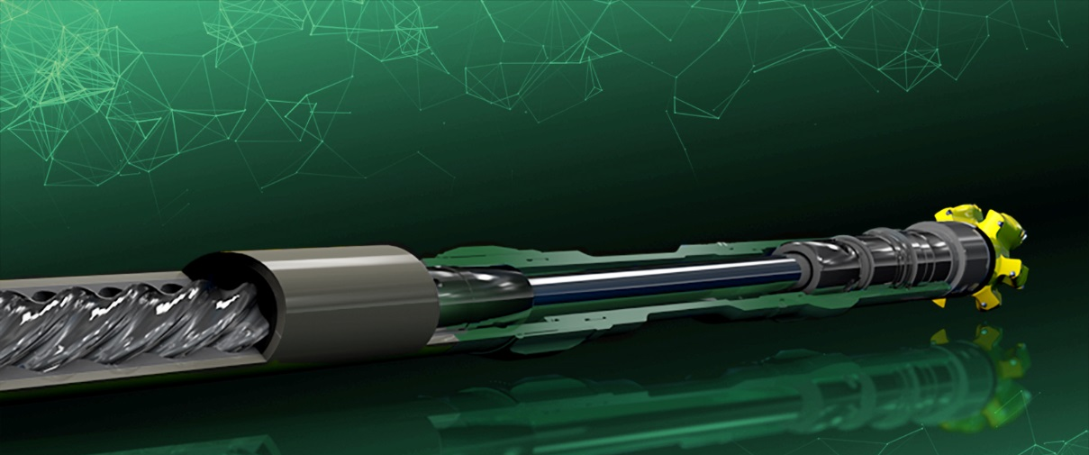
5-1/8-in. DuraMax motor platform
Specifications
Short bit-to-bend | 4.1 ft
High load, long life PDC bearings | 40 klbs WOB
Increased flow rate | 360 gpm
Increased torque output (ft-lb) | +15%
Increased power output (HP) | +35%
Available power sections
Pre-contoured | 1.00 rpg, 5/6, 13 stage
Pre-contoured | 0.75 rpg, 5/6. 9.5 stage
Conventional | 0.75 rpg, 5/6, 9.5 stage
Conventional | 0.50 rpg, 5/6, 6.5 stage
Copyright 2020 Baker Hughes Company. All rights reserved. 81664

Slide 7
DuraMax motor nomenclature
Power section
C = Conventional
P = Pre-contoured
Number of lobes (rotor)
implies ⁵/₆ lobe geometry
DuraMax
D100-5130C
Number of stages
Implied decimal after the
second number
i.e. 130 = 13.0 stages; 065 = 6.5 stages
Revolutions per gallon (RPG)
Implied decimal after the first number
i.e. 100 = 1.00 rpg; 075= 0.75 rpg
Copyright 2020 Baker Hughes Company. All rights reserved. 81664

Slide 8
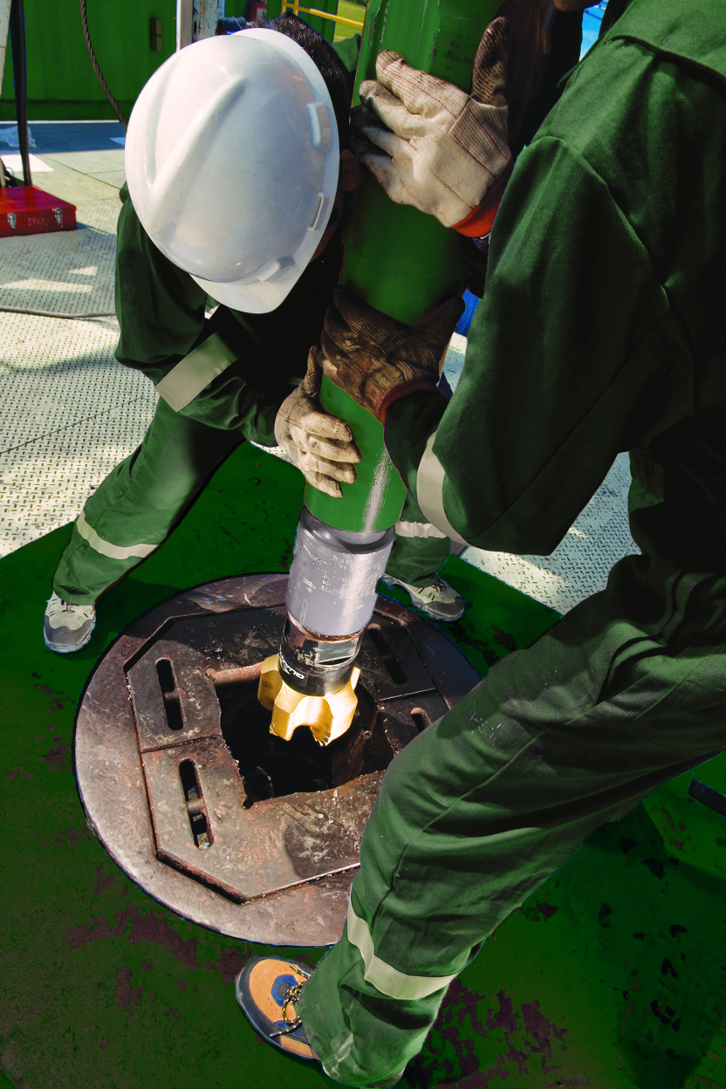
DuraMax motor nomenclature examples
Size | Nomenclature | Description
5-1/8 | D100-5130P | 1.00 revolutions per gallon, 5/6 rotor/stator, 13 stages, Pre-contoured stator
5-1/8 | D75-5095P | 0.75 revolutions per gallon, 5/6 rotor/stator, 9.5 stages, Pre-contoured stator
5-1/8 | D50-5065P | 0.50 revolutions per gallon, 5/6 rotor/stator, 6.5 stages, Pre-contoured stator
5-1/8 | D100-5130C | 1.00 revolutions per gallon, 5/6 rotor/stator, 13 stages, Conventional stator
5-1/8 | D75-5095C | 0.75 revolutions per gallon, 5/6 rotor/stator, 9.5 stages, Conventional stator
5-1/8 | D50-5065C | 0.50 revolutions per gallon, 5/6 rotor/stator, 6.5 stages, Conventional stator
5-1/8 | D25-5030C | 0.25 revolutions per gallon, 5/6 rotor/stator, 3 stages, Conventional stator
Copyright 2020 Baker Hughes Company. All rights reserved. 81664

Slide 9
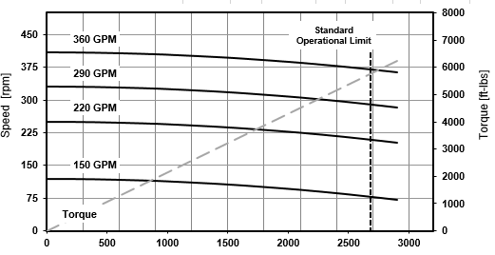
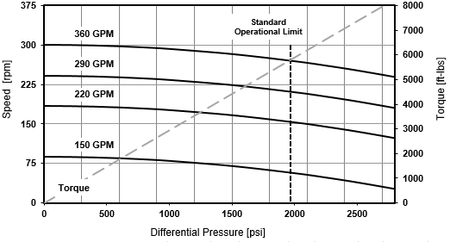
Pre-contoured power section
5-1/8-in. D100-5130P
5-1/8-in. D075-5095P
RPG: 1.00
Stages: 13.0
Flow Rate: 105 – 360 gpm
Diff. Pressure: 2,685 psi
Op. Power: 405 hp
Op. Torque: 5,780 ft-lbs
Max. Power: 540 hp
Max. Torque: 7,685 ft-lbs
RPG: 0.75
Stages: 9.50
Flow Rate: 105 – 360 gpm
Diff. Pressure: 1,965 psi
Op. Power: 295 hp
Op. Torque: 5,770 ft-lbs
Max. Power: 395 hp
Max. Torque: 7,675 ft-lbs
Copyright 2020 Baker Hughes Company. All rights reserved. 81664

Slide 10
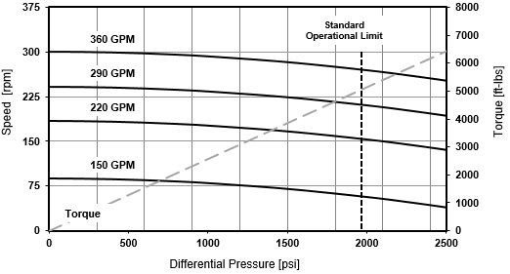
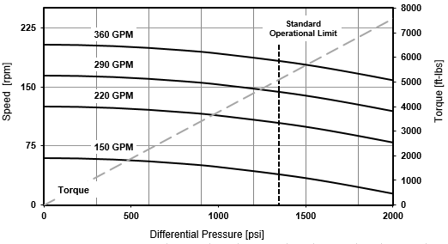
Conventional power section
5-1/8-in. D75-5095C
5-1/8-in. D50-5065C
RPG: 0.75
Stages: 9.50
Flow Rate: 105 – 360 gpm
Diff. Pressure: 1,965 psi
Op. Power: 260 hp
Op. Torque: 5,050 ft-lbs
Max. Power: 345 hp
Max. Torque: 6,715 ft-lbs
RPG: 0.50
Stages: 6.50
Flow Rate: 105 – 360 gpm
Diff. Pressure: 1,785 psi
Op. Power: 175 hp
Op. Torque: 5,095 ft-lbs
Max. Power: 235 hp
Max. Torque: 6,775 ft-lbs
Copyright 2020 Baker Hughes Company. All rights reserved. 81664

Slide 11
DuraMax motor nomenclature
Power section
C = Conventional
P = Pre-contoured
Number of lobes (rotor)
implies ⁵/₆ lobe geometry
DuraMax
D100-5130C
Number of stages
Implied decimal after the
second number
i.e. 130 = 13.0 stages; 065 = 6.5 stages
Revolutions per gallon (RPG)
Implied decimal after the first number
i.e. 100 = 1.00 rpg; 075= 0.75 rpg
Copyright 2020 Baker Hughes Company. All rights reserved. 81664

Slide 12
DuraMax motor nomenclature examples
Size | Nomenclature | Description
5-1/8 | D100-5130P | 1.00 revolutions per gallon, 5/6 rotor/stator, 13 stages, Pre-contoured stator
5-1/8 | D75-5095P | 0.75 revolutions per gallon, 5/6 rotor/stator, 9.5 stages, Pre-contoured stator
5-1/8 | D50-5065P | 0.50 revolutions per gallon, 5/6 rotor/stator, 6.5 stages, Pre-contoured stator
5-1/8 | D100-5130C | 1.00 revolutions per gallon, 5/6 rotor/stator, 13 stages, Conventional stator
5-1/8 | D75-5095C | 0.75 revolutions per gallon, 5/6 rotor/stator, 9.5 stages, Conventional stator
5-1/8 | D50-5065C | 0.50 revolutions per gallon, 5/6 rotor/stator, 6.5 stages, Conventional stator
5-1/8 | D25-5030C | 0.25 revolutions per gallon, 5/6 rotor/stator, 3 stages, Conventional stator
Copyright 2020 Baker Hughes Company. All rights reserved. 81664

Slide 13
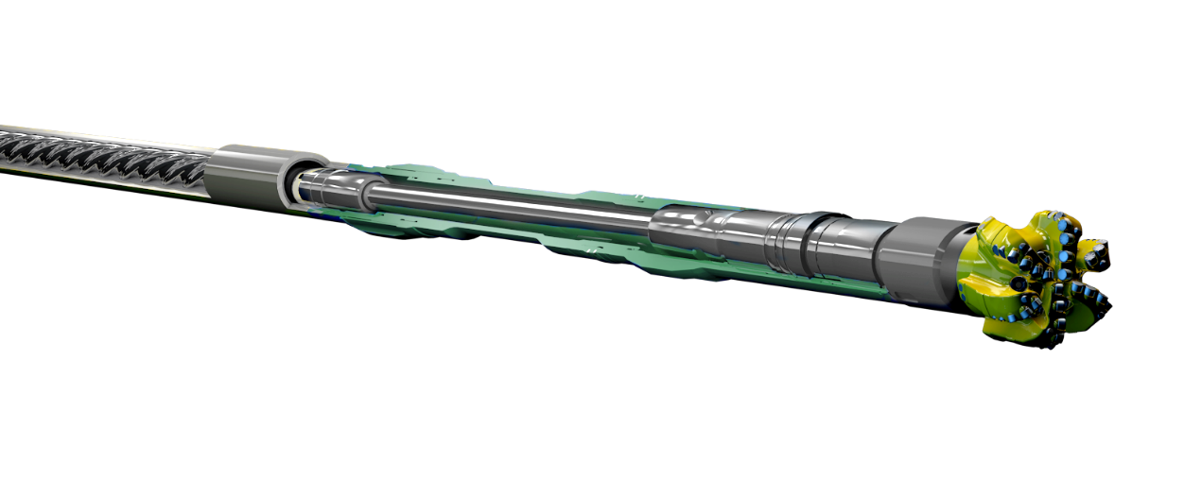
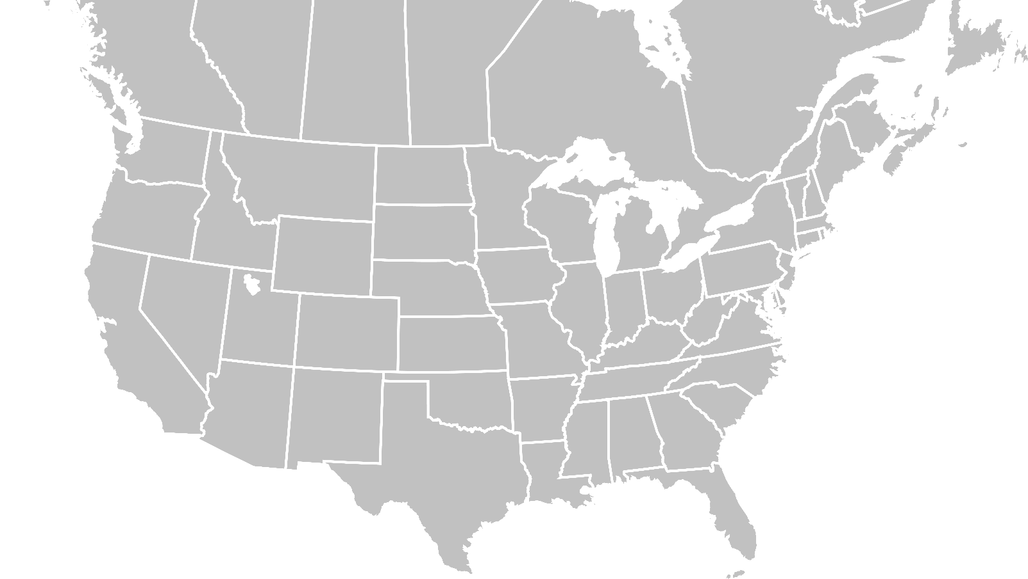

DuraMax high-performance motors
Rockies (Bakken, Three Forks, Powder River Basin), Permain (Wolfcamp A, B, Lower Sprayberry), and Canada
Rockies (Bakken, Three Forks, Powder River Basin), Permain (Wolfcamp A, B, Lower Sprayberry), and Canada
>650,000
>10KFT / 46 HRS.
+25%-40%
FASTEST LATERAL DRILLED
ROP
FEET DRILLED AND
116 RUNS
36
SINGLE RUN
TD~9k-10k FT
(AS OF MID-APRIL 2019)
30%
DOUBLE DISTANCE DRILLED
CONSISTENT
PER DAY IN PERMIAN
TF CONTROL
FASTER CURVE
SECOND FASTEST
WITH EASY AND
13 DEG./100 FT
LATERAL ON FIRST RUN
EFFICIENT SLIDING
Copyright 2020 Baker Hughes Company. All rights reserved. 81664
Notes:
As of mid-April; Rockies (Bakken, Three Forks, Powder River Basin); Permian (Wolfcamp A, B, Lower Sprayberry); Canada
116 Runs
>650,000 ft. drilled
7,000 CH; 5,700 DH

Slide 14
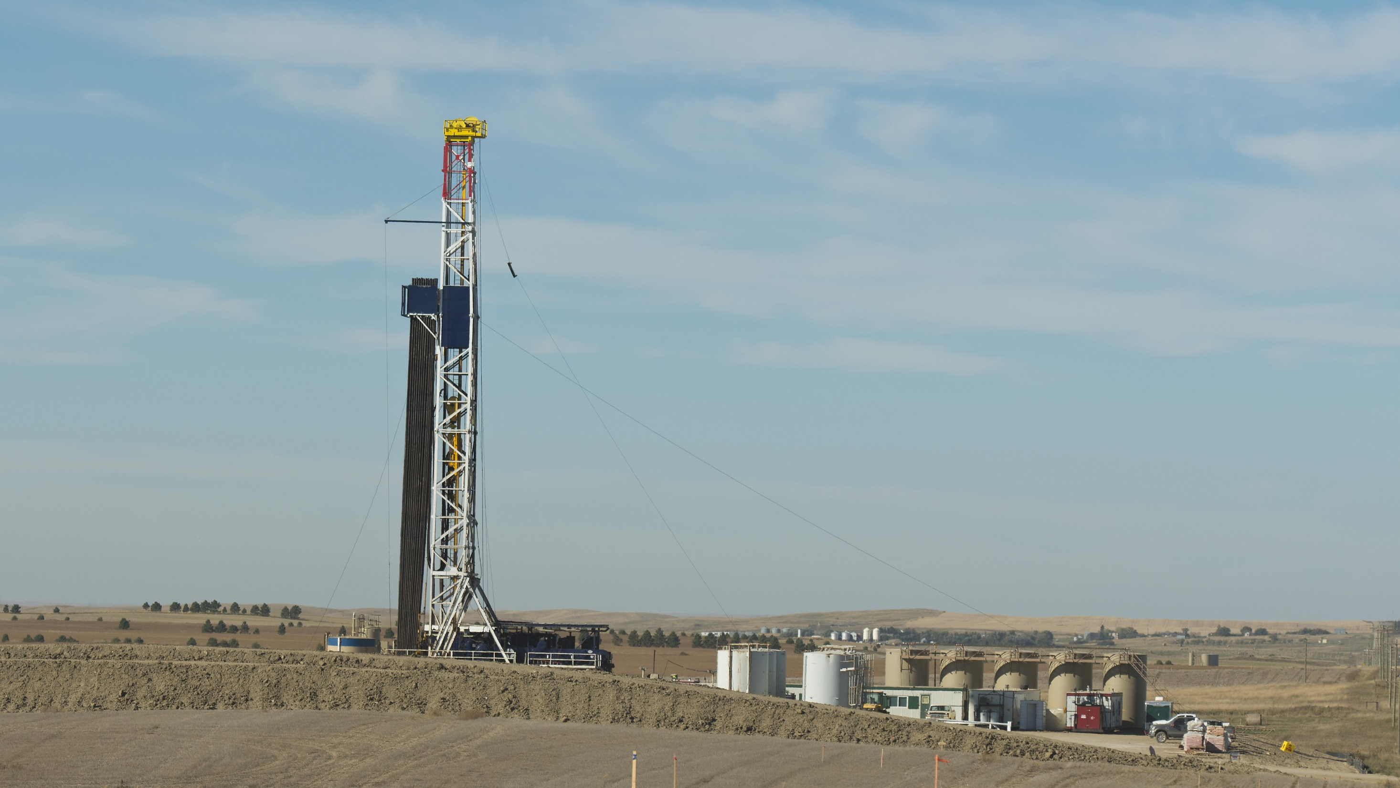
Case study: Williston Basin, North Dakota
5 ¹/₈-in. DuraMax motor
DRILLED
FASTEST
SAVED
10,294 FT.
LATERAL
3.3
LATERAL IN
DRILLED
46
FOR CUSTOMER
DRILLING DAYS
LOW VIBRATION
DRILLING HOURS
FOOTPRINT AND
SMOOTH POWER
DELIVERY
Copyright 2020 Baker Hughes Company. All rights reserved. 81664
Notes:
Published
The Challenges
Drill 6” lateral section in single run
Minimize sliding for well path corrections
Minimize vibrations to avoid MWD failures
Consistent power delivery to avoid Bit failure or wear out
Baker Hughes solution
5 1/8” DuraMax D75-5095P

Slide 15

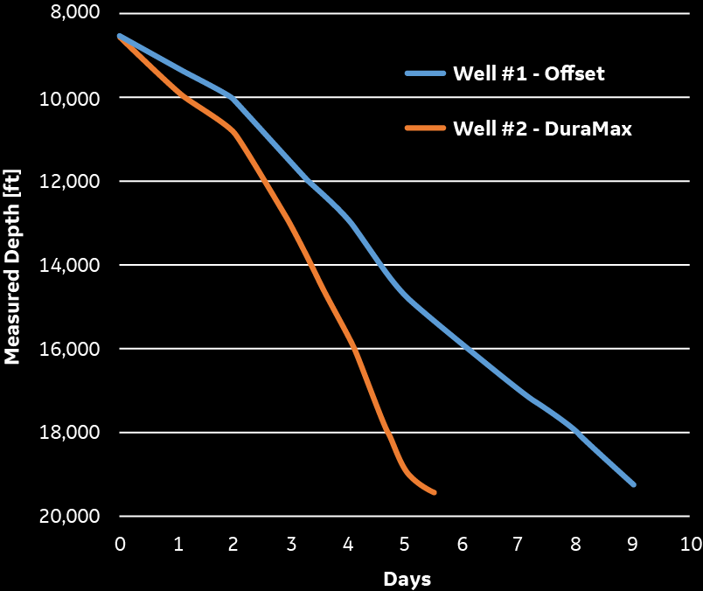
Case study: Midland County, Texas, Wolfcamp A
5 ¹/₈-in. DuraMax motor
SAVED
DRILLED
DELIVERED
3 DAYS
7,652 FT. IN
CONSISTENT
80
BURN IN CURVE
OF RIG TIME
ACHIEVED
MAINTAINED
DRILLING HOURS
3,127
FEET
PER
DAY
114 FT./HR ROP
OF DAILY FOOTAGE
Copyright 2020 Baker Hughes Company. All rights reserved. 81664
Notes:
The Challenges
Comparison of Motor technologies
Drill curve @10deg./100ft. BUR
Drill 6 ¾” lateral section
Baker Hughes solution
5 1/8” DuraMax D75-5095C

Slide 16
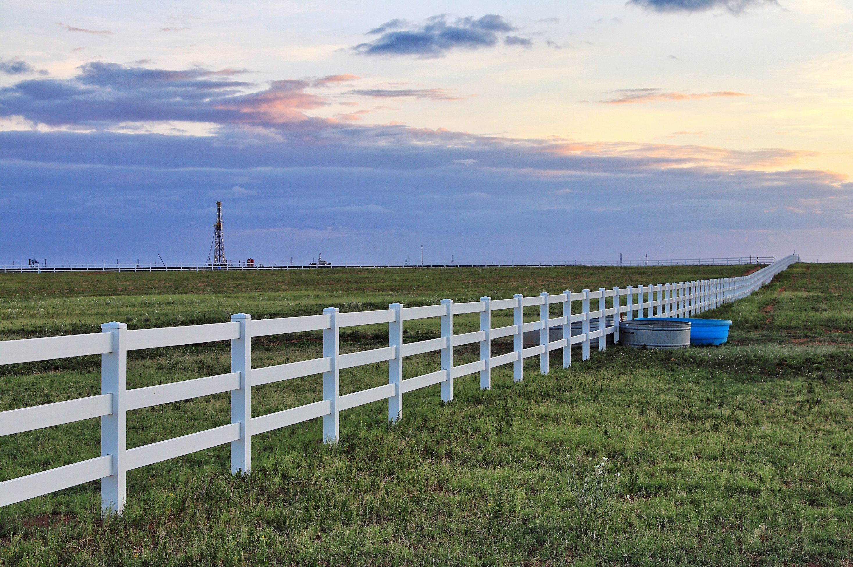
Case study: Midland County, Texas
5 ¹/₈-in. DuraMax motor
ONE-RUN
DRILLED
9.5%
MAINTAINED ROP
65
FEET
PER
HOUR
LATERAL
9,529 FT.
TO TOTAL DEPTH
INCREASE
LATERAL IN
17.1%
145
IN AVERAGE
FOOTAGE/DAY
INCREASE
IN AVERAGE
DRILLING HOURS
OVERALL ROP
Copyright 2020 Baker Hughes Company. All rights reserved. 81664
Notes:
Published
The Challenges
Drill 6 ¾” lateral section to TD in single run
Formation push
Baker Hughes solution
5 1/8” DuraMax D50-5065C & Dynamus extended-life PDC drill bit

